Slide 1
Salary Predictions of Data Professions
Nadia Nur Oktaviani Sukma

Slide 2
Problem Statement!
Salaries in the field of data professions vary widely based on factors such as experience, job role, and performance. Accurately predicting salaries for data professionals is essential for both job seekers and employers.

Slide 3
TABLE OF CONTENTS
01
04
02
05
03
Machine Learning Model Development and Model Evaluation
Exploratory Data Analysis (EDA)
Feature Engineering
ML Pipelines and Model Deployment
Data
Preprocessing
06
Recommendations

Slide 4



Exploratory Data Analysis (EDA)
Exploratory Data Analysis (EDA) is a crucial step in the data analysis process where we use statistical graphics and other data visualization methods to summarize the main characteristics of the data, often with visual methods.
Some of the EDAs that I use include:
Showing 5 Top Data Describe
Info
The purpose of this function is to display the top 5 of dataset
Provides a quick summary of the numerical (and optionally, categorical) data within a DataFrame.
To display information in the dataset

Slide 5
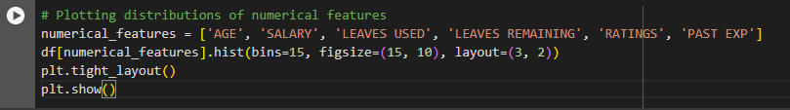
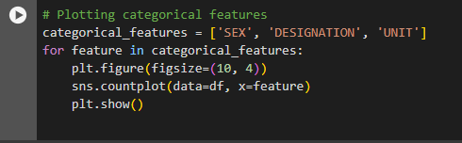
Exploratory Data Analysis (EDA) Visualization of the dataset
Plotting attributes in dataset that have numeric values
Plotting attributes in dataset that don’t have numeric values

Slide 6
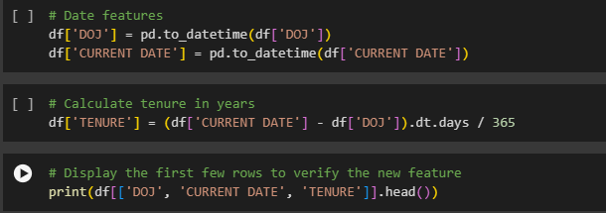
Feature Engineering
Creating New Feature
Create a new attribute as a value based on the union of the existing attribute values
in the dataset.

Slide 7
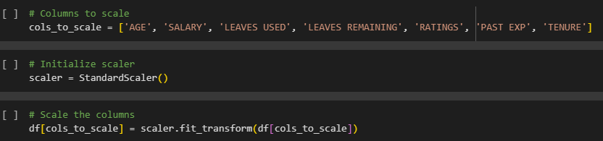
Transforming Existing Features
Transform existing features to improve model performance.

Slide 8

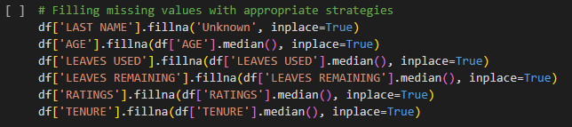
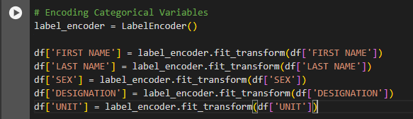
Data Preprocessing
Data Preprocessing has several stages, the first is handling empty values
Then encoding categorical variables into numeric ones.

Slide 9
Data Preprocessing
Splitting the Data
Define features and target variable. Split the data into training and testing sets.

Slide 10
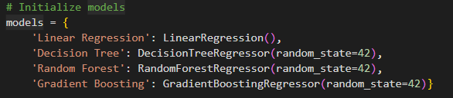

Machine Learning Model Development
Initialize Models
Purpose :
To find the best performing model with various machine learning regression models to predict salary and
experiment with different algorithms.
Train Model
is responsible for training machine learning models using training data. This includes the process where the model learns from the data to find patterns or relationships that can then be used to make predictions on new data.

Slide 11
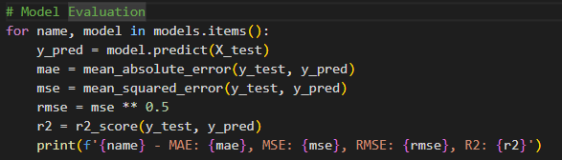
Model Evaluation
To display the results of trained models
Result:
Model | MAE | MSE | RMSE | R2
Linier Regression | 0.31 | 0.28 | 0.53 | 0.77
Decision Tree | 0.13 | 0.06 | 0.25 | 0.95
Random Forest | 0.12 | 0.07 | 0.26 | 0.95
Gradient Boosting | 0.13 | 0.08 | 0.29 | 0.93

Slide 12
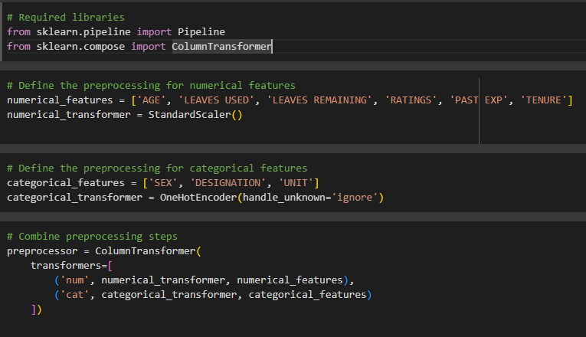
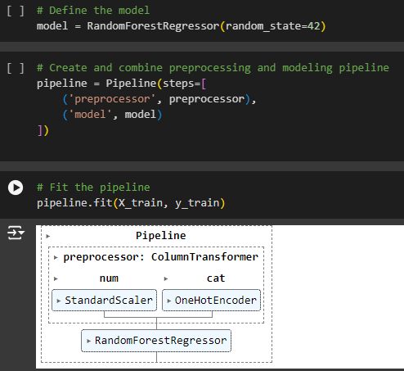
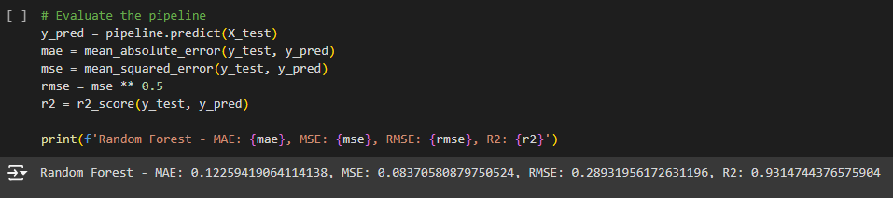
ML Pipelines and Model Deployment
In this step, I will create an end-to-end machine learning pipeline and apply the model to generate predictions for unseen data. I will use the scikit-learn pipeline to simplify the process and FastAPI for deployment.

Slide 13
Recommendations
Based on the findings from the models, especially the Random Forest which performed best, here are key recommendations to improve salaries in data professions: continuously develop technical skills and pursue advanced education, gain relevant experience through challenging projects, strategically choose high-paying locations and industries, research market trends for effective salary negotiation, and engage in professional networking and mentorship programs. Implementing these strategies can enhance earnings and career prospects in data professions.

Slide 14
Thank you for your attention

